Slide 1


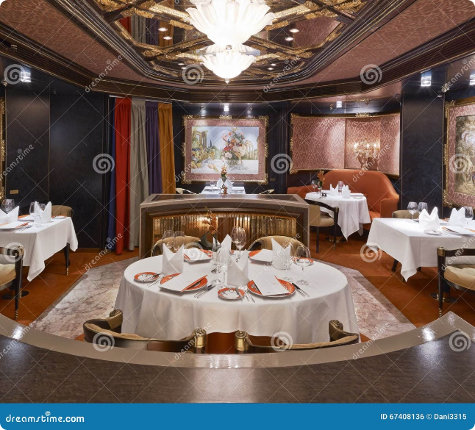
Restaurant Table Booking
Done
By
J. Chiranjevi Anil
N.V. Tharun Kumar
S. Sai Sravan
Guided
By
Dr. Jayasakthi Velmurugan K

Slide 2
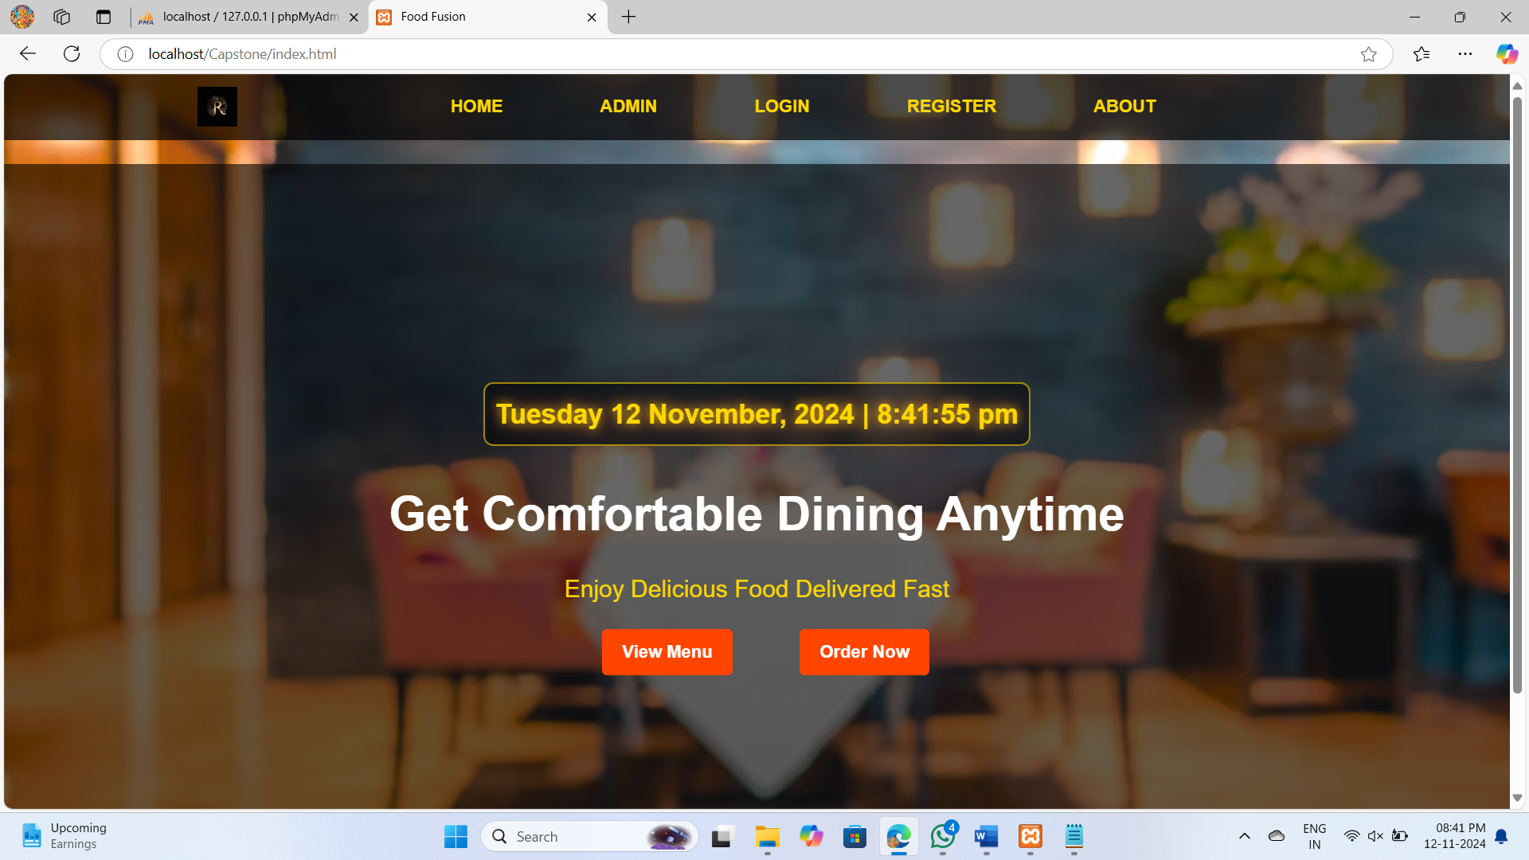
s
Introduction
Obsolescence of Traditional Methods Highlights the drawbacks of traditional table booking methods like phone reservations, including miscommunication, errors, and double bookings.
Customer Expectations Notes the growing expectation for online management of dining experiences, including browsing menus and booking tables.
Solution: Restaurant Table Booking System Introduces the system as a solution to the problems of traditional booking methods by providing an online platform for effortless table reservations.
Benefits for Restaurant Managers Points out that the system aids restaurant managers in handling reservations more effectively, ensuring a seamless dining experience.
Project Goals The project aims to design, develop, and implement a comprehensive table booking system tailored for modern restaurants and their patrons.

Slide 3

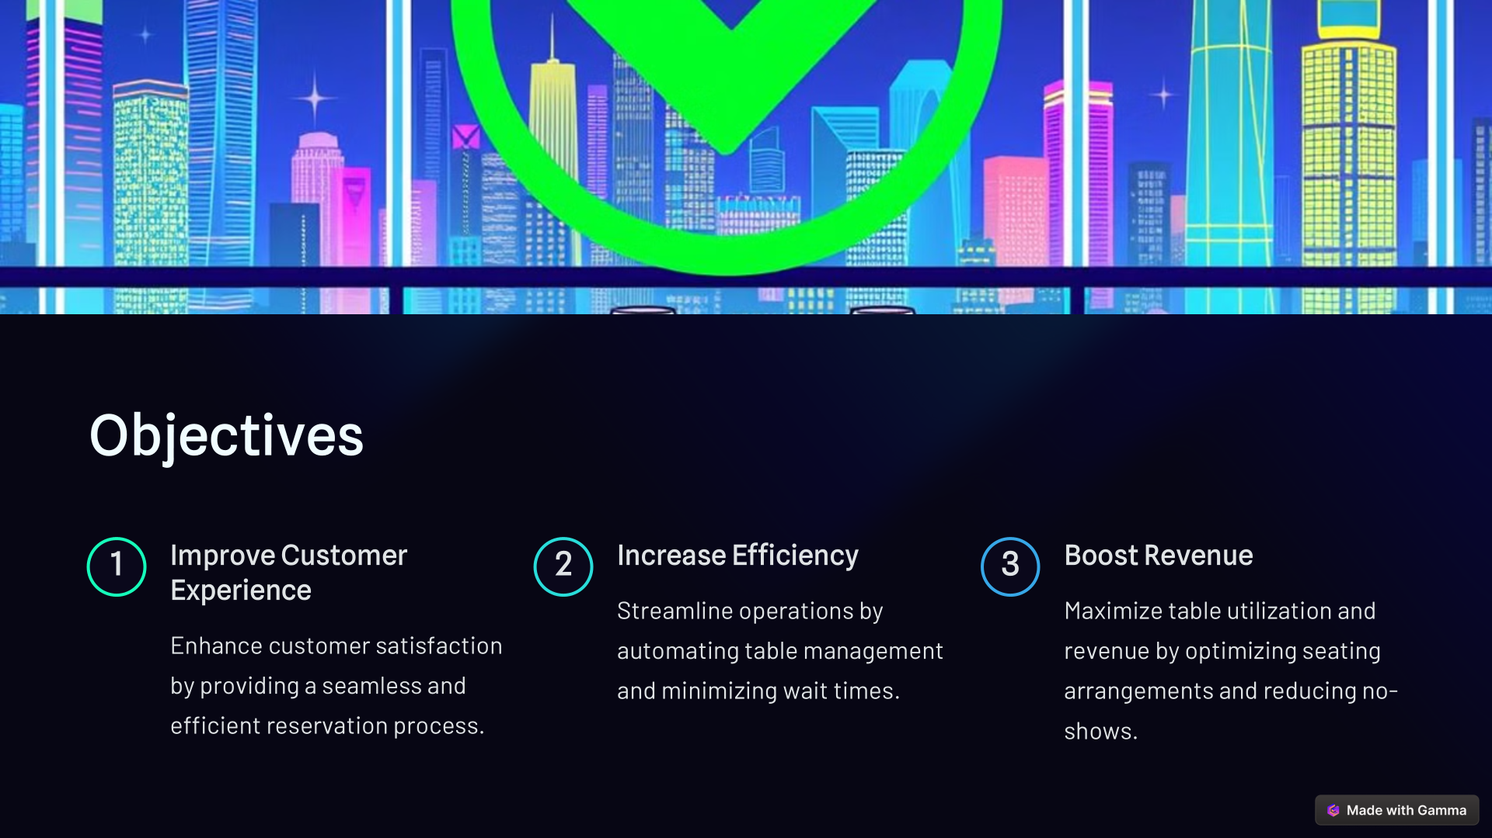
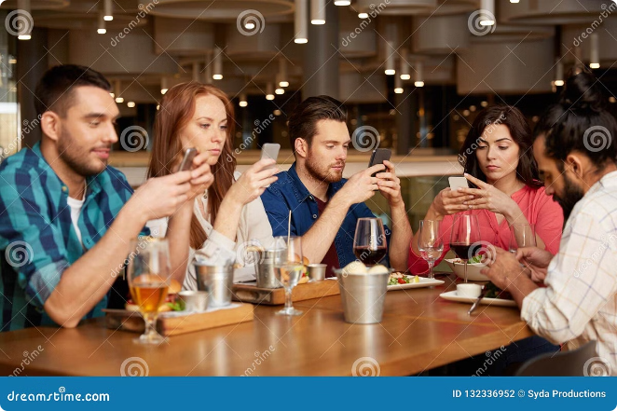
Objectives:
1
Increase Reservations
2
Improve Efficiency
3
Enhance Customer Experience
4
Data-Driven Insights

Slide 4
Exciting System:
Drawbacks System:
OpenTable:
Large network of over 31
million diners, easy access for guests
to make reservations anytime,
enhanced visibility through photos
and menu displays, and options for
text message confirmations.
High competition for visibility,
especially for smaller restaurants
without the budget to boost their
listings.
Basic plan at $39/month, Core
plan at $249/month, and
Pro plan at $449/month
Cost: Many platforms have significant
monthly fees.
Competition: Especially on popular
platforms like OpenTable, the
competition for visibility is fierce,
making it harder for smaller
Marketing Limitations: Some platforms
offer limited marketing support

Slide 5
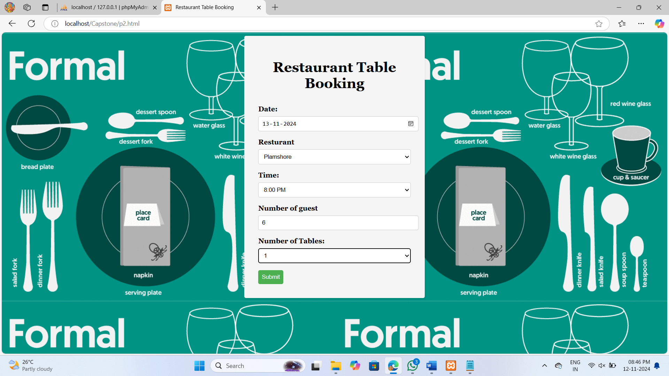
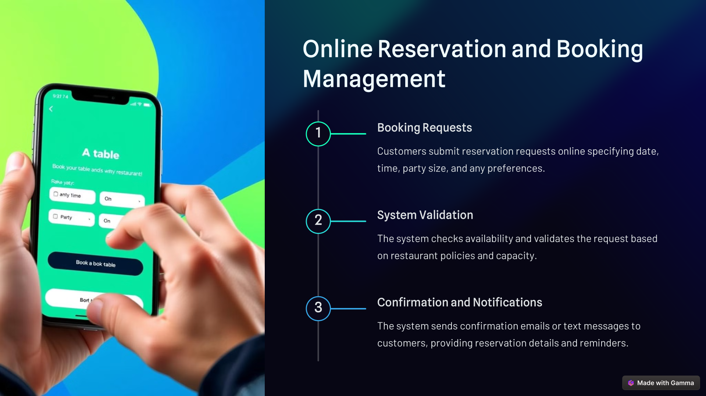

Slide 6
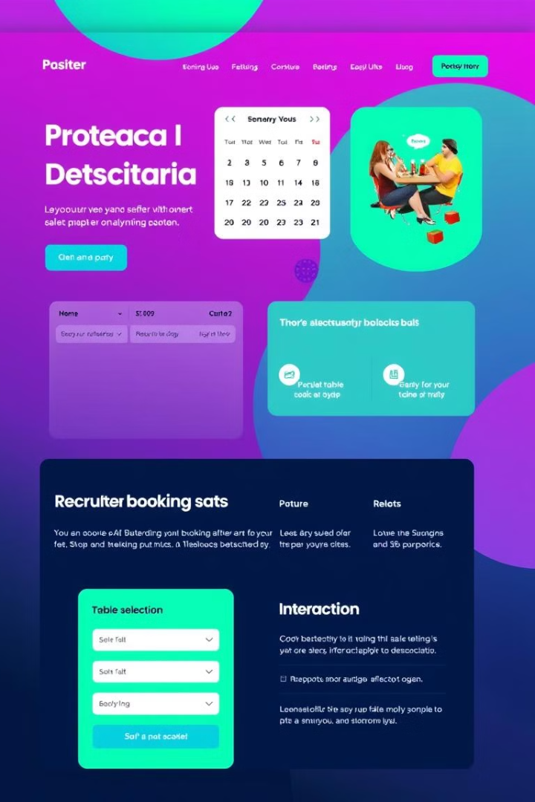
Key Features of a Restaurant Table Booking System
Online Reservations
Real-Time Availability
Allow customers to book tables online from anywhere at any time, increasing accessibility and convenience.
Display accurate and up-to-date table availability, preventing double bookings and ensuring a smooth reservation experience.
Waitlist Management
Efficiently manage waitlists, notifying customers of their estimated wait time and allowing them to join the queue remotely.

Slide 7

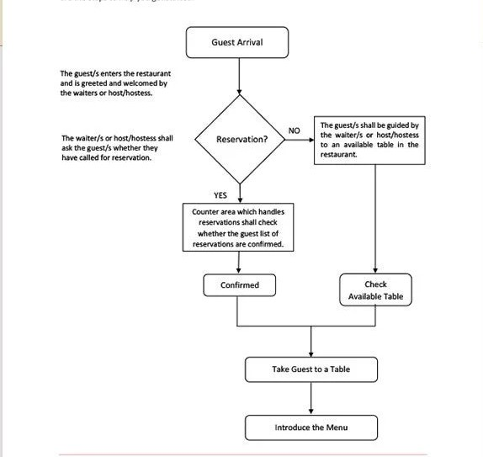
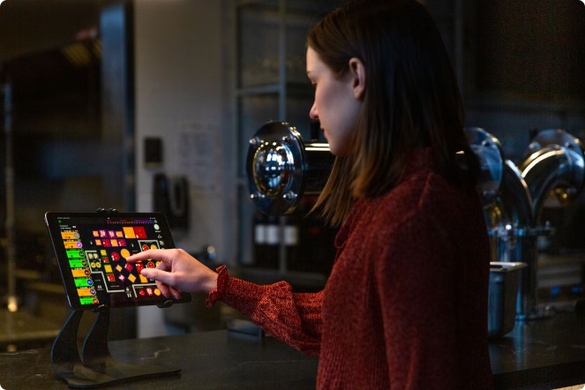
Flow-chart

Slide 8
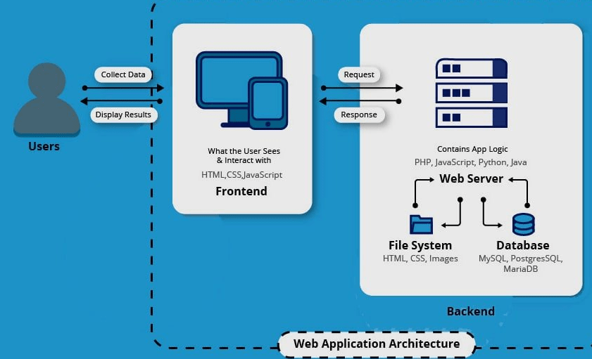
HTML: Hypertext Markup Language
It is used to design or structure of the web page
CSS: Cascading Style Sheet
It is used to make style and color full web site
JavaScript : it is scripting language main purpose validating
the user’s input.
Php: Hypertext Preprocessor
Php is server side scripting language is used to make
Connection to database to insert data and retriew the data.
MySQL: Stucture Query Language
MySQL is database used to store the information about the
Client registration, login detail, restarent information etc

Slide 9
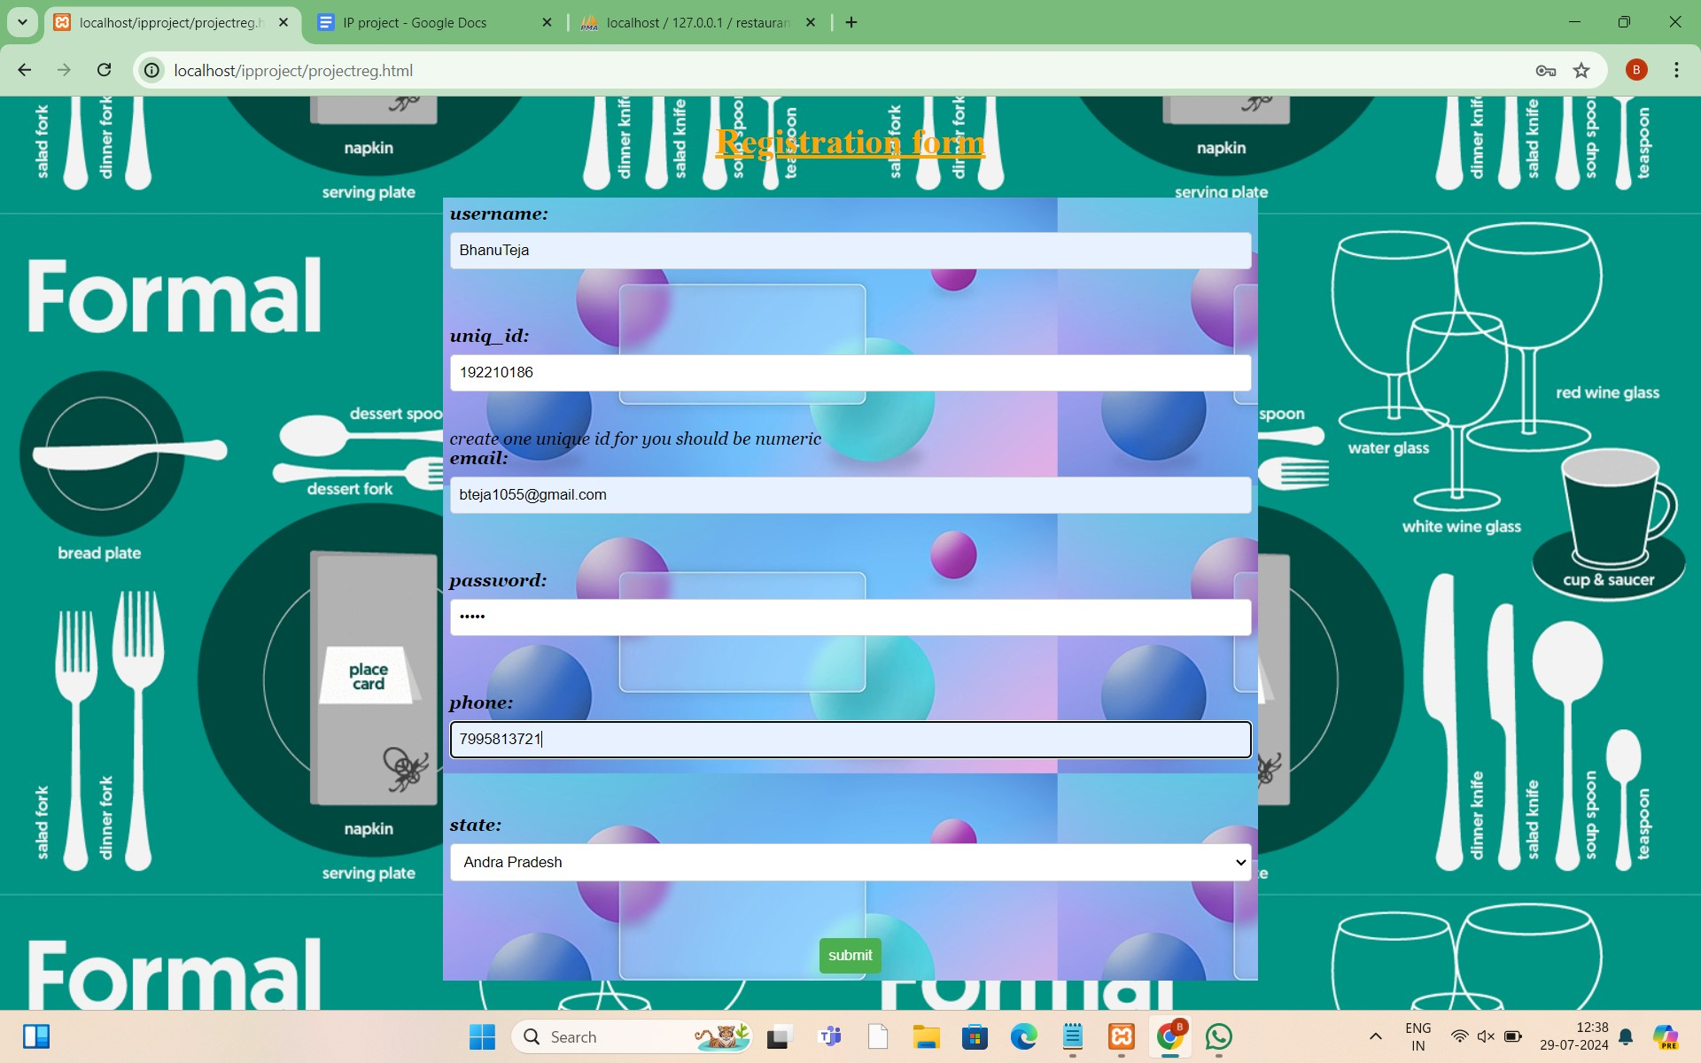
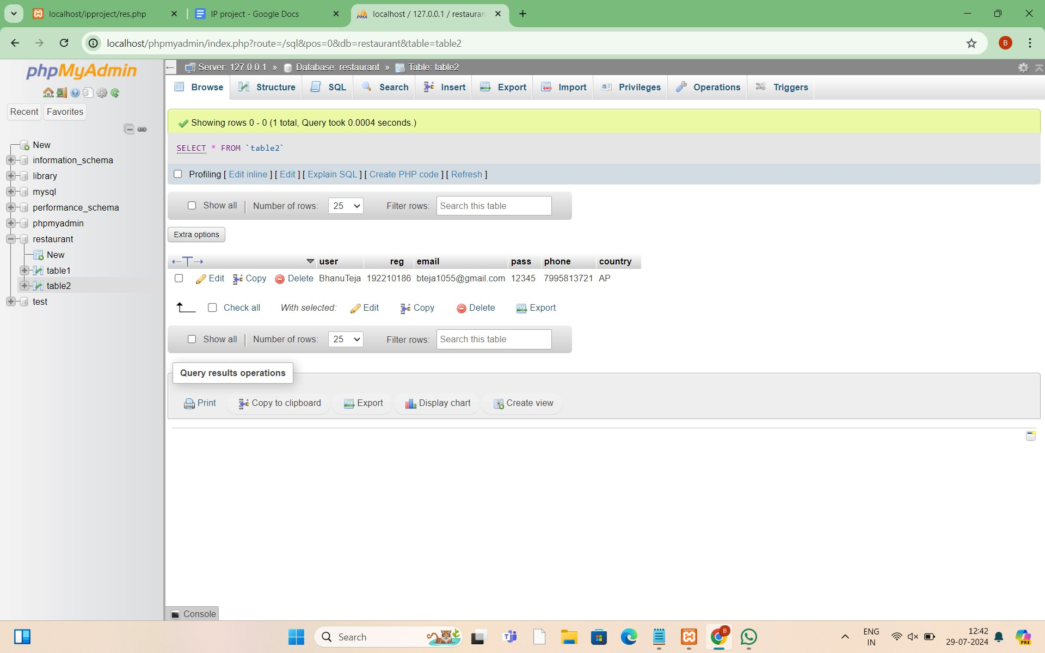
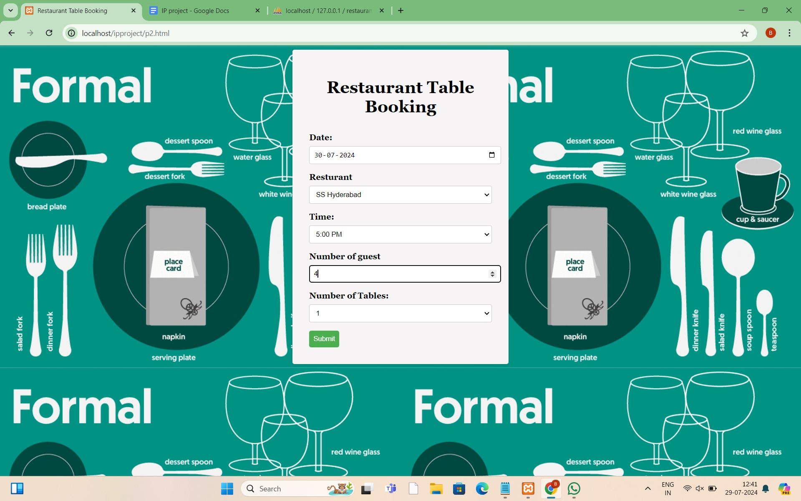
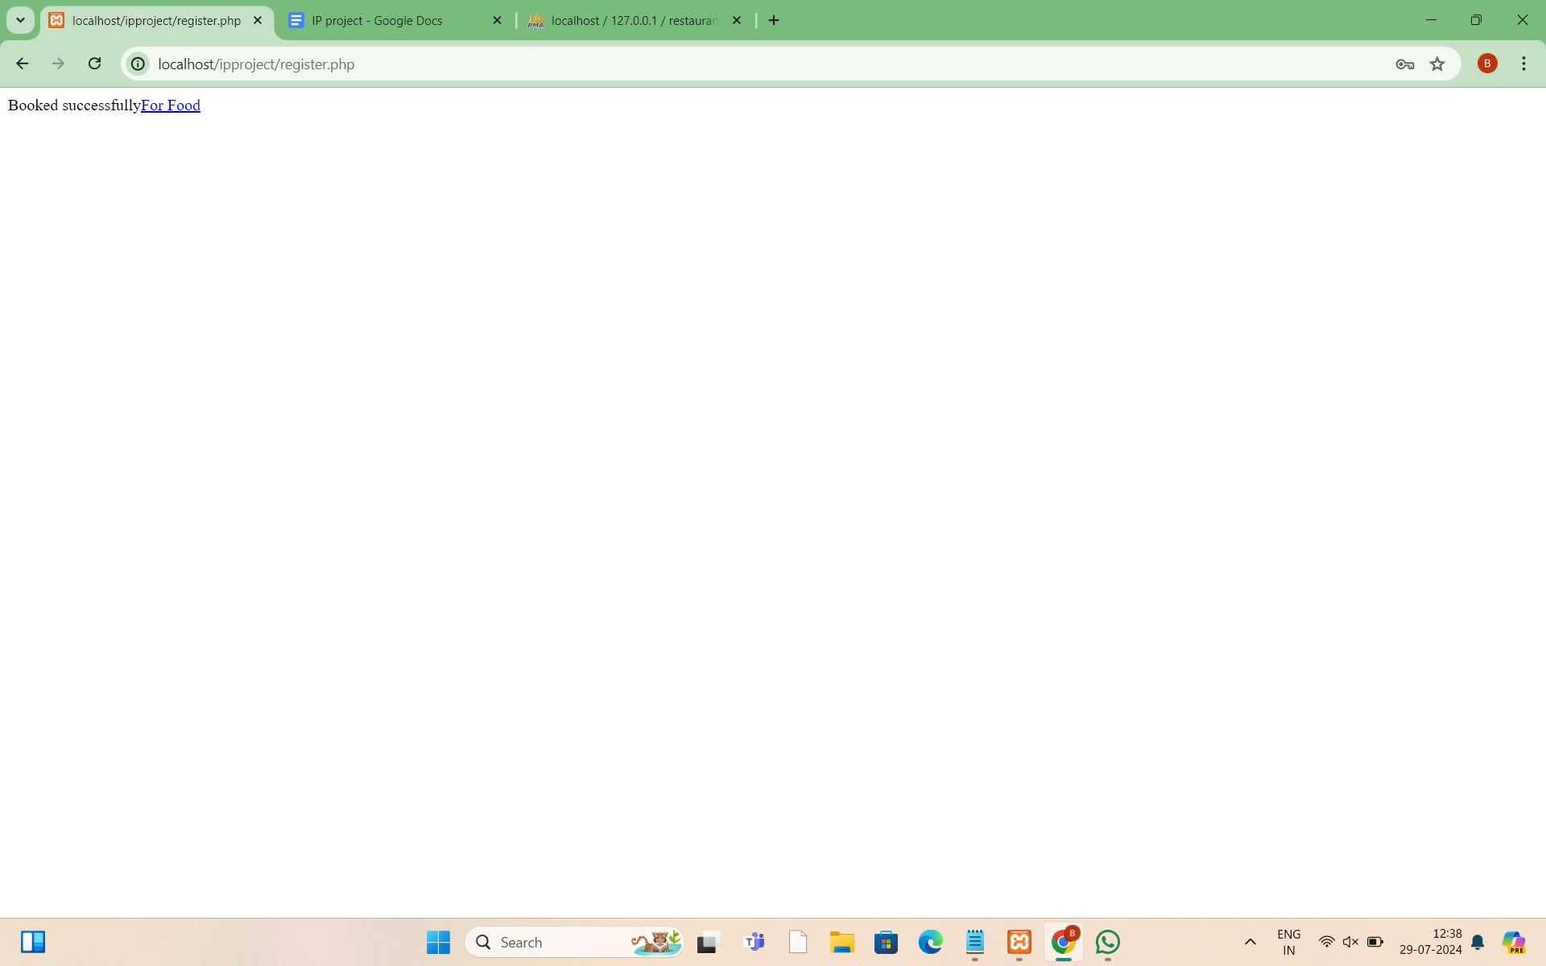
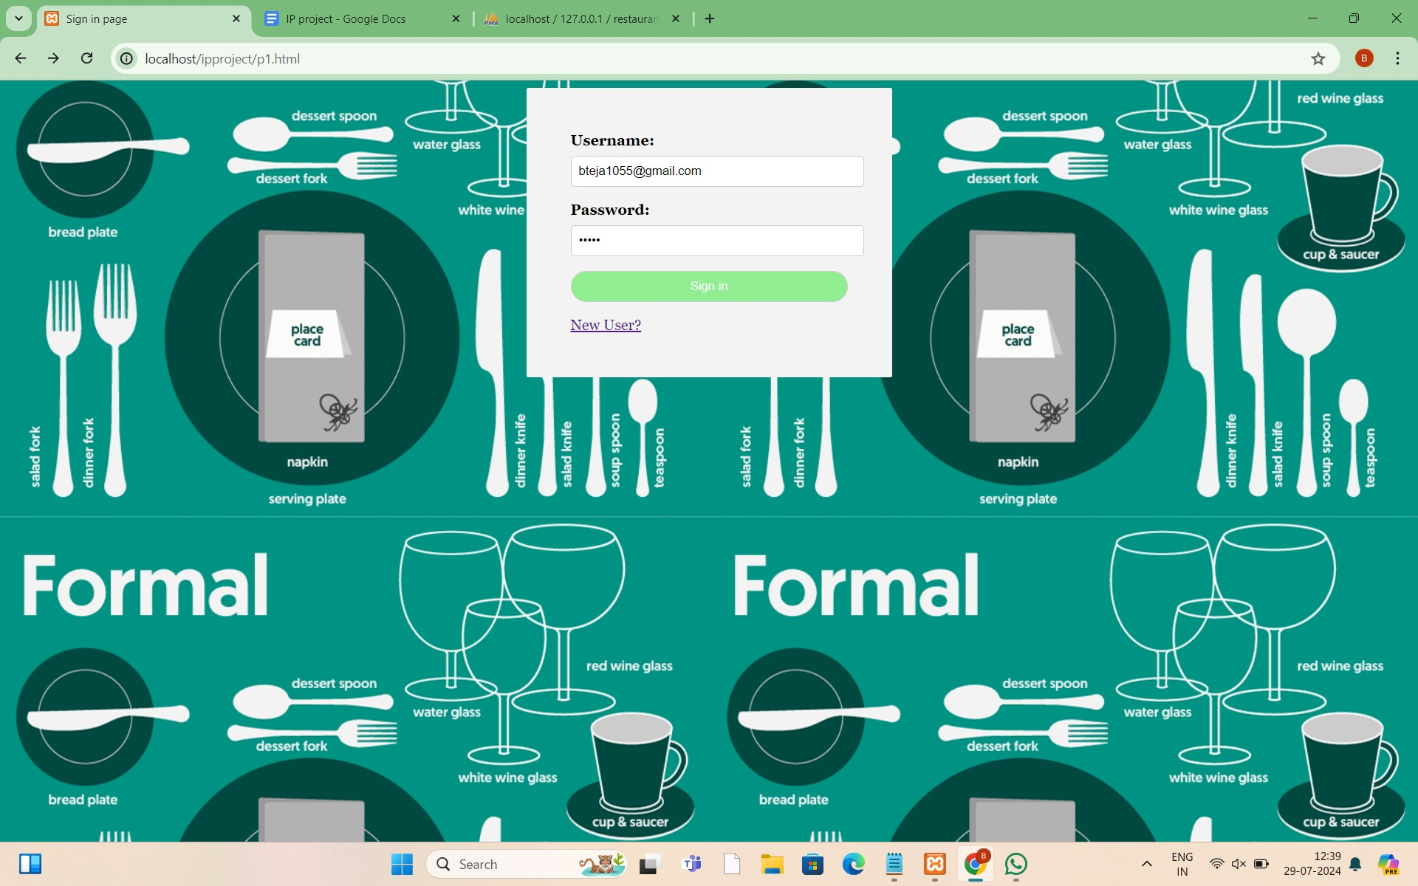
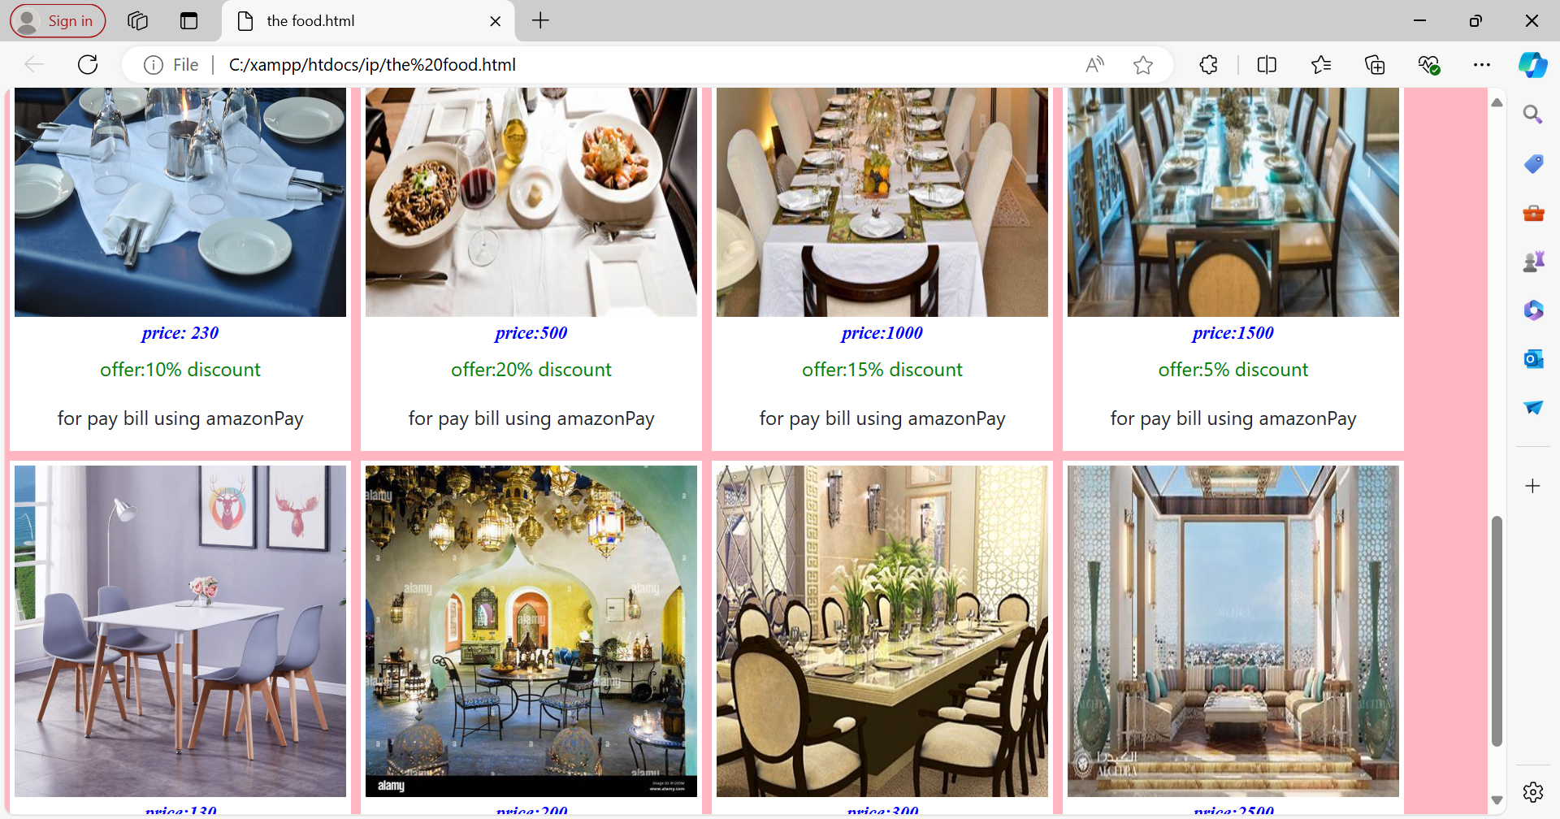

Slide 10

Challenges and Considerations
Integration with POS Systems
Data Security and Privacy
Scalability and Performance
Maintaining customer data privacy and security in compliance with relevant regulations.
Ensuring the system can handle high volumes of reservations and traffic, especially during peak hours.
Seamless integration with existing point-of-sale (POS) systems for accurate order processing and billing.

Slide 11





Enhancing the Customer Experience
Convenience
Flexibility
Provide customers with a convenient and hassle-free way to book tables.
Offer flexible scheduling options to accommodate various dining preferences.
Communication
Personalization
Keep customers informed through timely confirmations and notifications.
Accommodate special requests and preferences to create a personalized experience.

Slide 12
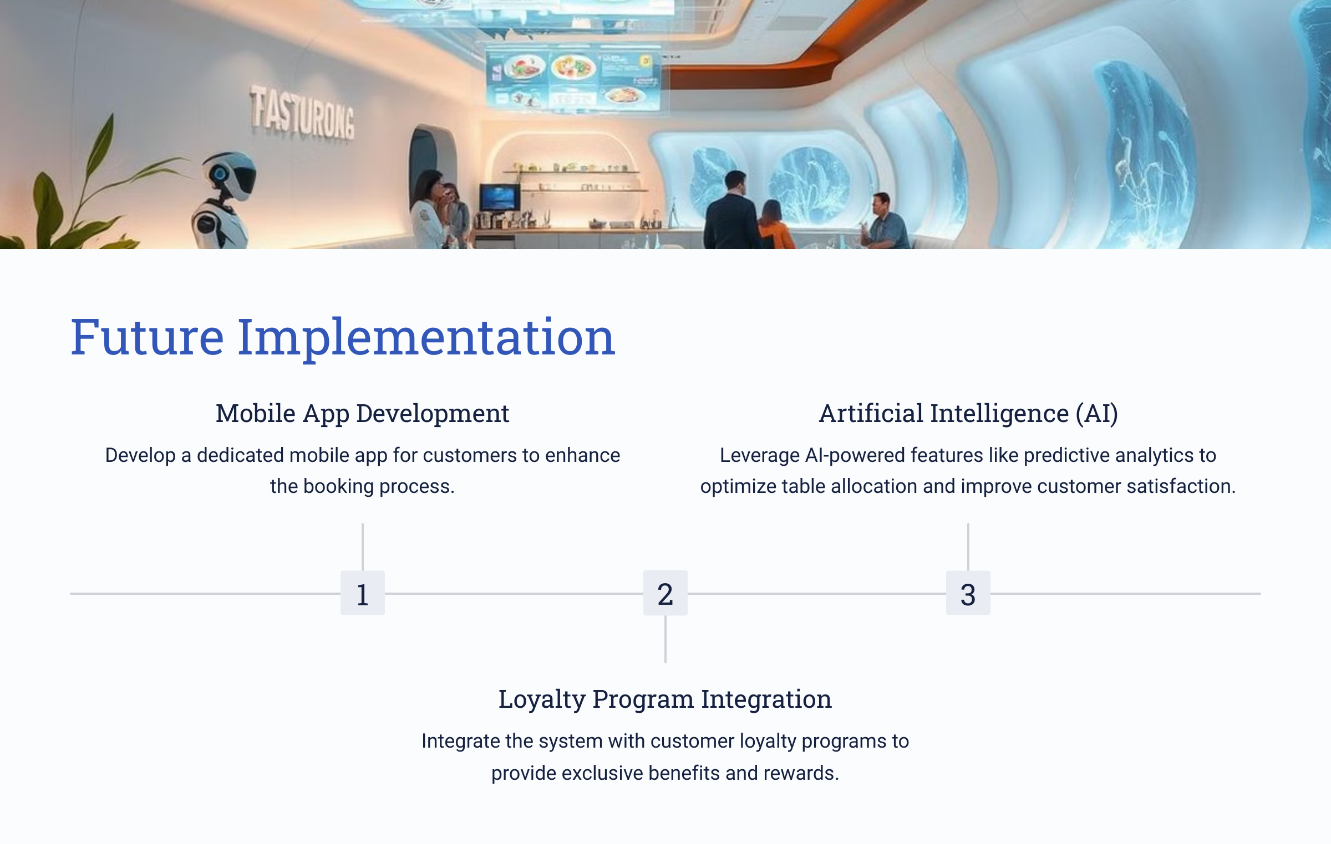
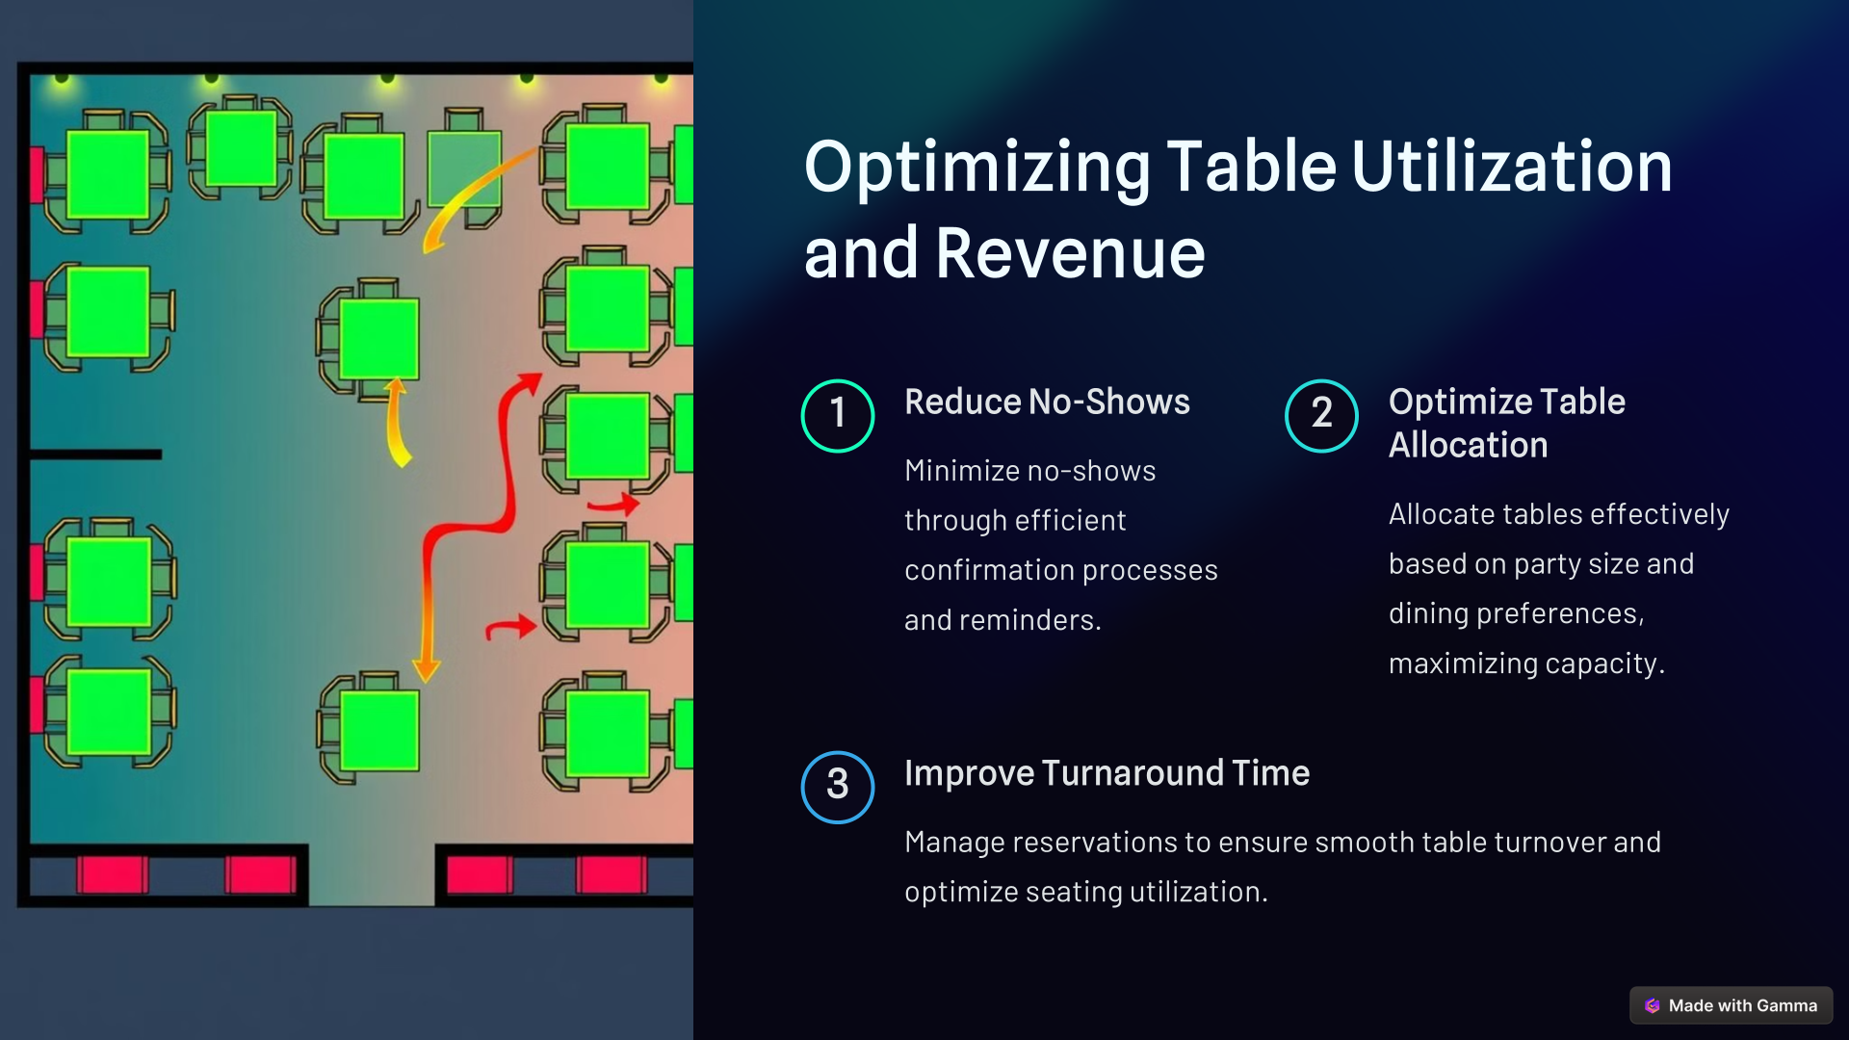

Slide 13

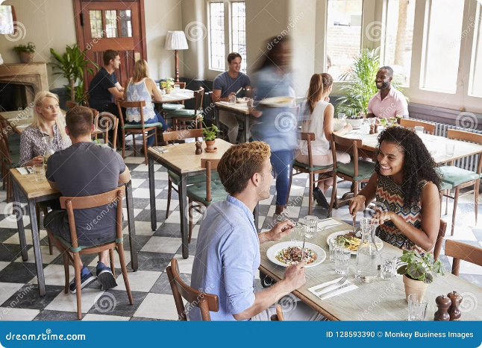
Conclusion
Online table booking systems offer a comprehensive solution for restaurants looking to modernize their operations and enhance customer experiences.
Our system provides a user-friendly interface, real-time availability, automated confirmations, and customizable features, empowering restaurants to optimize reservations, streamline management, and improve customer satisfaction.
Contact us today to learn more about our table booking solution and unlock the full potential of your restaurant.

Slide 14


